Slide 1
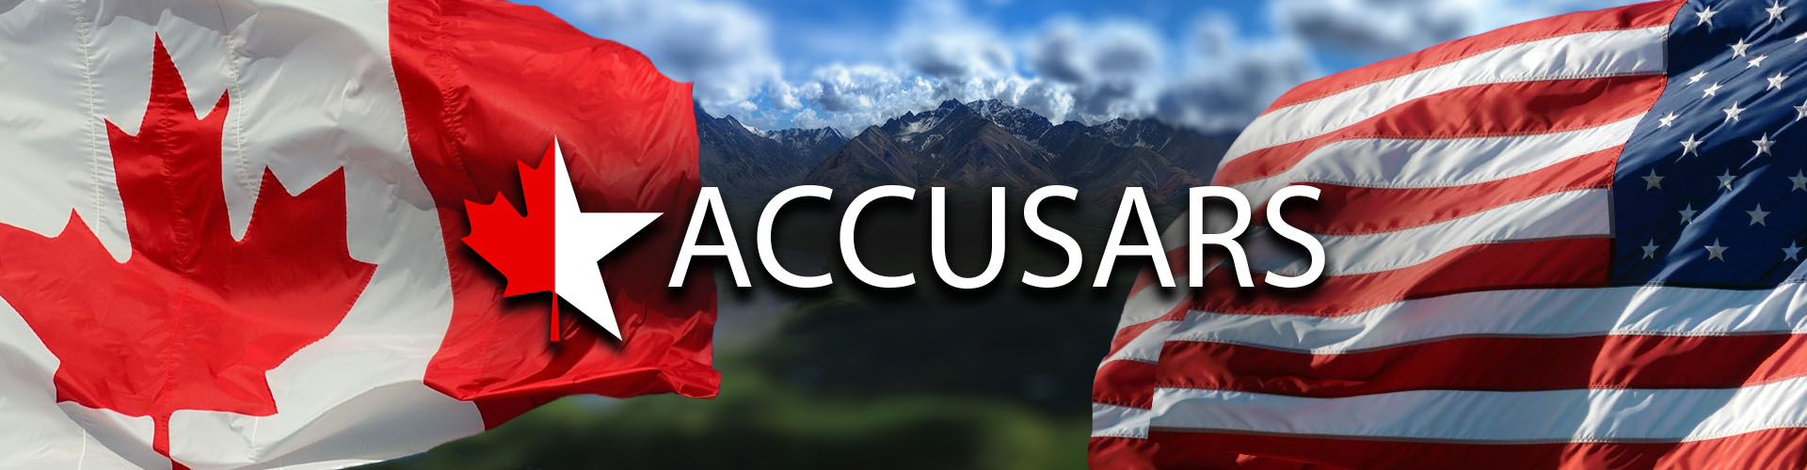
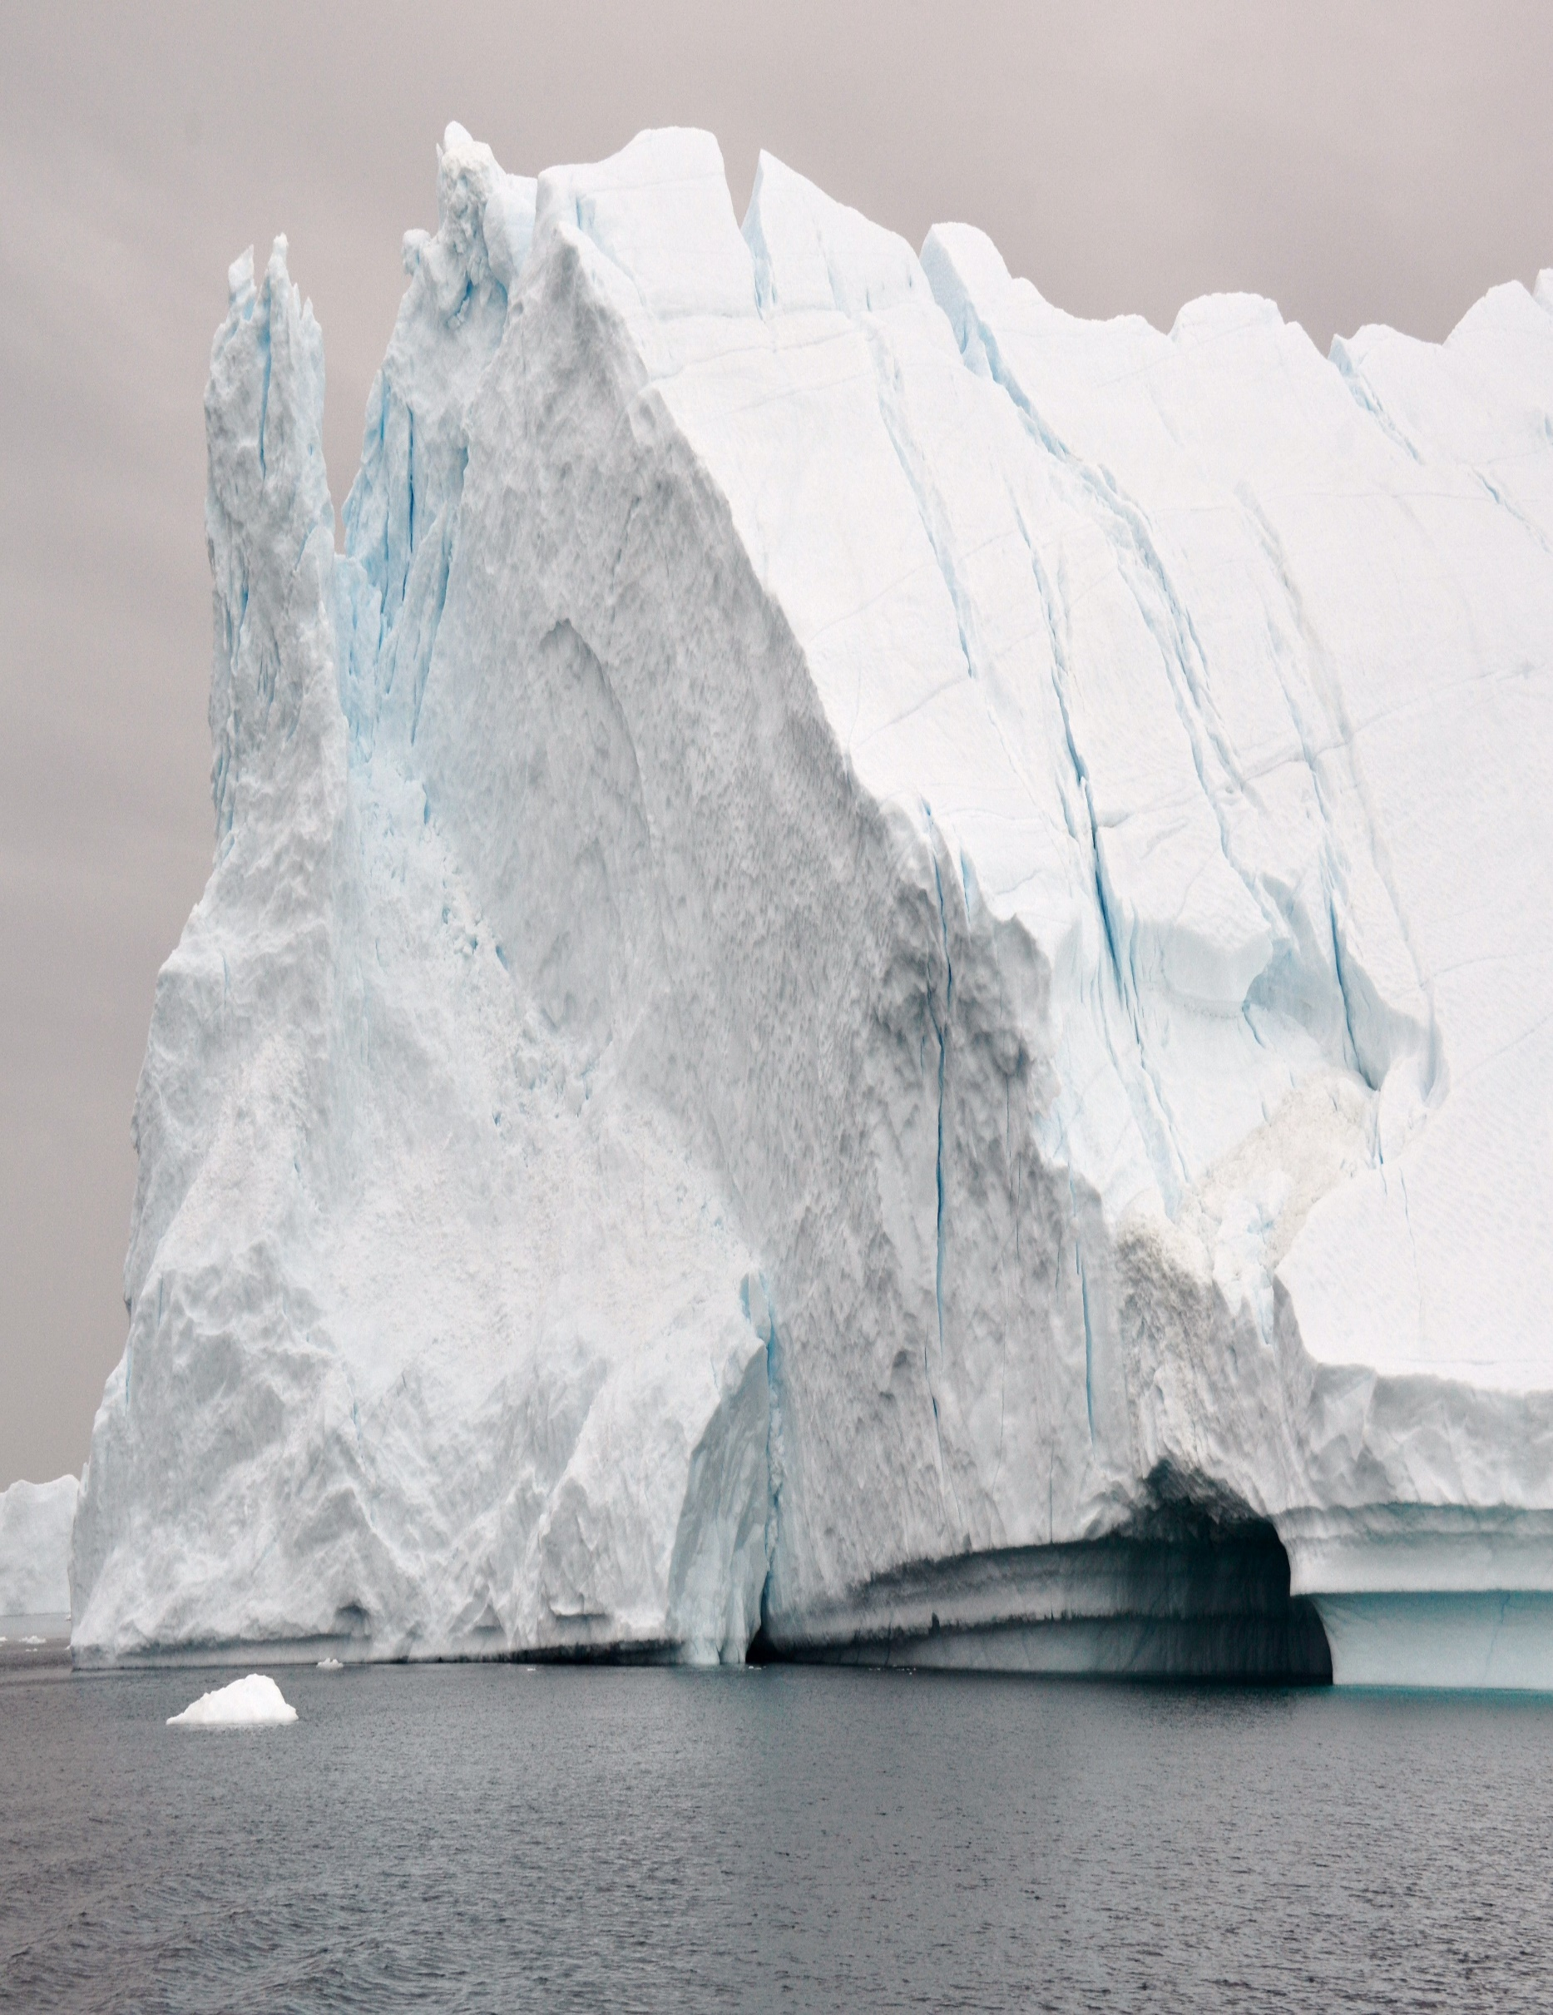
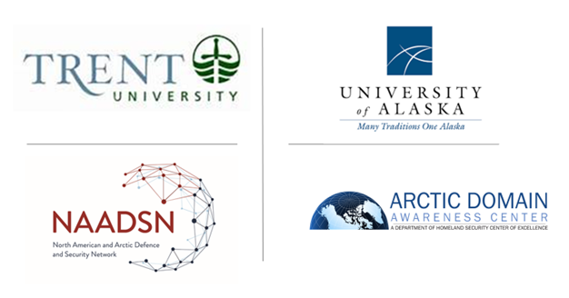
In support of the North American and Arctic Defense and Security Network (NAADSN)
Welcome Arctic minded Professionals to
Advancing Collaboration in Canada-U.S. Arctic
Regional Security II (ACCUSARS II)
A Strategic Foresight Exercise Sequel
Specifically, oriented for the U.S. and Western Canadian Arctic Regions
26 March 2021
Continuing from ACCUSARS I, ACCUSARS II seeks to examine the emerging trends in the medium- and long-term aspects in the North American Arctic security environment to create a useful Strategic Foresight Assessment oriented to the U.S. and Western Canadian Arctic regions (Alaska, Yukon and Northwest Territories).
Via gathering of academics and practitioners at this workshop, organizers will seek to anticipate potential North American Arctic futures using SFA methods to better identify and codify the understood capability gaps and shortfalls in identifying future risks, challenges and opportunities across Canada-U.S. security collaboration to better protect Canada and U.S. sovereign interests in the Arctic.
Workshop Hosts

Slide 2
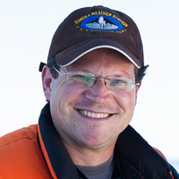
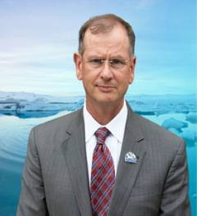
In support of the North American and Arctic Defense and Security Network (NAADSN)
0800-0810 ADT/1000-1010 MDT/1200-1210 EDT
Administrative Remarks by Dr. Whitney Lackenbauer, Network Lead, North American Arctic Defence and Security Network, Trent University, and Maj Gen (Ret), Church Kee, USAF, Executive Director, Arctic Domain Awareness Center, University of Alaska.
Note: All ACCUSARS II Materials are located at https://arcticdomainawarenesscenter.org/EventHub_ACCUSARS-II

Slide 3
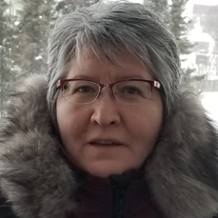
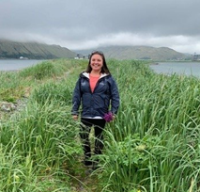

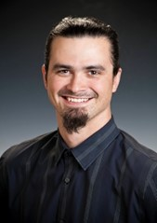
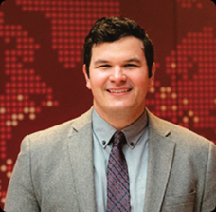
In support of the North American and Arctic Defense and Security Network (NAADSN)
0810-0930 ADT/1010-1130 MDT/1210-1330 EDT
ACCUSARS II Panel #3. Arctic Residents of Alaska and Western Canada: Arctic Security starts here.
Panel Moderator: Maj Conrad Schubert, Joint Task Force North, Yellowknife NWT.
Panelists:
Ms. Bridget Larocque, Policy Advisor/Researcher, Arctic Athabaskan Council Yellowknife, Northwest Territories.
Dr. Liza Mack, Executive Director, Aleut International Association, Anchorage, Alaska.
Mr. Ted Smith, Tribal Health Emergency Preparedness Manager, Alaska Native Tribal Health Consortium, Anchorage, Alaska.
Mr. Nagruck Harcharek, Director of Operations, (and former Director of Science) Ukpeagvik Inupiat Corporation, Utqiagvik, Alaska
Dr. Peter Kikkert, Irving Shipbuilding Chair of Arctic Policy and Assistant Professor of Public Policy, St. Francis Xavier University, St. Francis Xavier University, Antigonish, Nova Scotia.

Slide 4
In support of the North American and Arctic Defense and Security Network (NAADSN)
0930-0940 ADT/1130-1140 MDT/1330-1340 EDT
Break

Slide 5
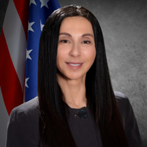
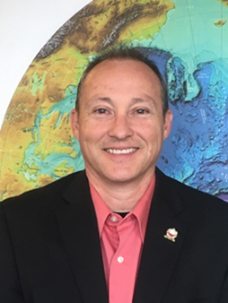
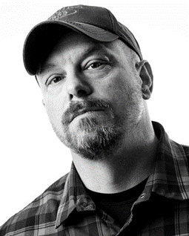
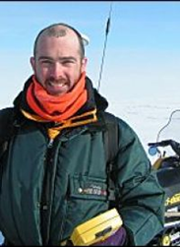
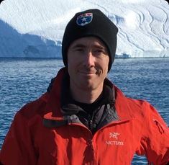
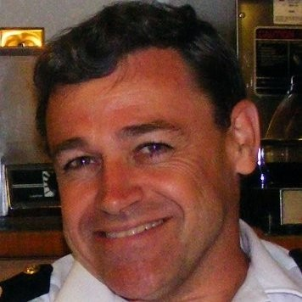
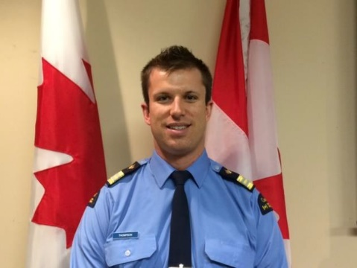
In support of the North American and Arctic Defense and Security Network (NAADSN)
0940-1050 ADT/1140-1250 MDT/1340-1450 EDT:
ACCUSARS II Panel #3.The Insights into Maritime operations and environmental change.
Panel Moderator: Troy Bouffard, Center for Arctic Security and Resilience, UAF, Fairbanks, Alaska
Panelists:
Dr. Lilian “Doc” Alessa, President’s Professor, University of Idaho, Moscow Idaho.
Mr. Shannon Jenkins, USCG, USCG Senior Arctic Policy Advisor, HQ USCG (CG-5PW).
Dr. Craig Tweedie, Professor, Biological Sciences - Environmental Science and Engineering - Environmental Science (College of Science) University of Texas, El Paso, Texas.
Dr. Adam Lajeunesse, Irving Shipbuilding Chair in Canadian Arctic Marine Security Policy and Assistant Professor at the Brian Mulroney Institute of Government, St. Francis Xavier University, Antigonish, Nova Scotia.
LCdr Hal Shiels, Royal Canadian Navy, Ottawa.
Mr. Steve Thompson, Acting Superintendent, Maritime Search and Rescue – Canadian Coast Guard, Arctic Region, Ottawa.

Slide 6
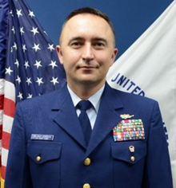

In support of the North American and Arctic Defense and Security Network (NAADSN)
1050-1105 ADT/1250-1305 MDT/1450-1305 EDT
Introduction to Strategic Foresight Activity 2. A 15 min orientation of Activity 2 by CDR Aaron Delano-Johnson, USCG and LCDR Ryan Hawn, USCG HQ USCG DCO-X (Evergreen), Washington D.C.

Slide 7
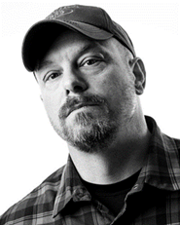
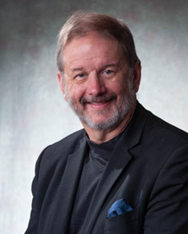
In support of the North American and Arctic Defense and Security Network (NAADSN)
1105-1220 ADT/1305-1420 MDT/1305-1420 EDT
Strategic Foresight Activity. Addressing and Prioritizing security concerns.
In four (4) breakout groups, ACCUSARS participants will identify key priorities for North American defence/defense and security collaboration, oriented to Alaska and Western Canada. Given the changing nature of the threats through/to/in the North American Arctic, are we investing in the right capabilities? Looking to the future, how can research & development help to identify and develop other capabilities that would support CANUS objectives in the Arctic? Breakout group monitors:
  Group 1: Political aspects - Moderated by Troy Bouffard, CASR, University of Alaska Fairbanks, Fairbanks Alaska.
  Group 2: The Roles of Remote Communities - Moderated by Dr. Lil Alessa, President’s Professor, University of Idaho, Moscow Idaho.
  Group 3: Environmental aspects - Moderated by Dr. Craig Tweedie, Professor, Biological Sciences - Environmental Science and Engineering - Environmental Science (College of Science) University of Texas, El Paso Texas.
  Group 4: Economic / Resources - Moderated by Dr. Rob Huebert, University of Calgary, Alberta.

Slide 8
In support of the North American and Arctic Defense and Security Network (NAADSN)
1220-1240 ADT/1420-1440 MDT/1620-1640 EDT
Arctic Research Priorities Activity
Reports and Discussion

Slide 9
In support of the North American and Arctic Defense and Security Network (NAADSN)
1240-1250 ADT/1440-1450 MDT/1640-1650 EDT
Final Workshop Wrap-up Remarks by Dr. Whitney Lackenbauer, Network Lead, North American Arctic Defence and Security Network, Trent University, and Maj Gen (Ret), Church Kee, USAF, Executive Director, Arctic Domain Awareness Center, University of Alaska.
Note: All ACCUSARS II Materials are located at https://arcticdomainawarenesscenter.org/EventHub_ACCUSARS-II

